Slide 1

Competitive Programming From Problem 2 Solution in O(1)
P
T
H
I
N
K
F
A
S
T
S
Installing CodeBlocks
Mostafa Saad Ibrahim
Teaching Assistant @ Cairo University

Slide 2
Installation Note
Any installation path or workspace path must be WITHOUT spaces
Make sure to get latest installers

Slide 3
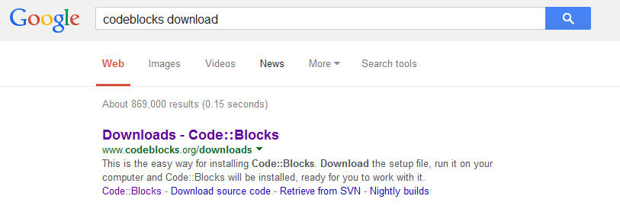
CodeBlocks: Google it

Slide 4
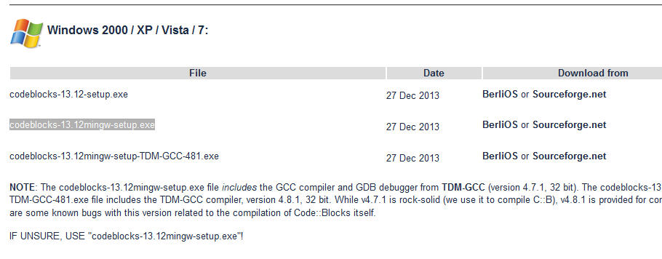
CodeBlocks: Select Mingw

Slide 5
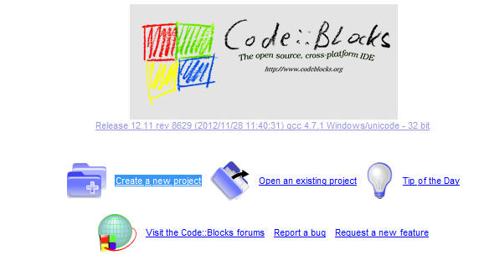
CodeBlocks: Install and Lanuch

Slide 6
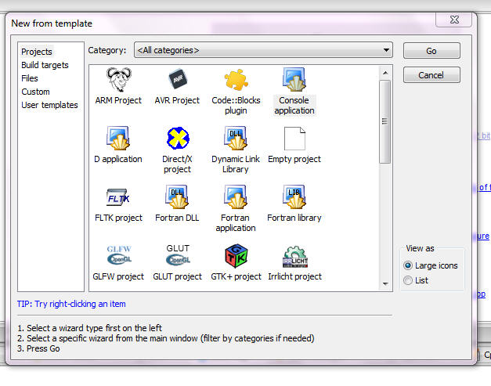
CodeBlocks: Console Project

Slide 7
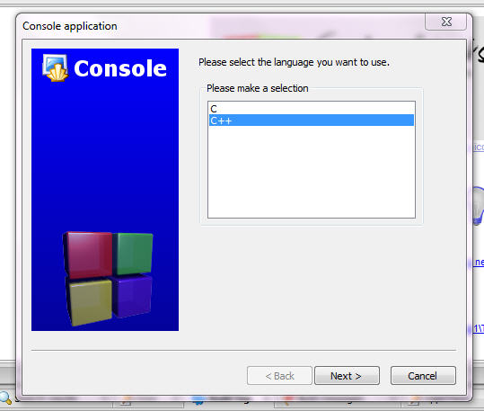
CodeBlocks: C++

Slide 8
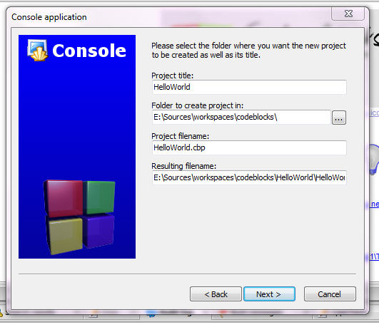
CodeBlocks: No Spaces!

Slide 9
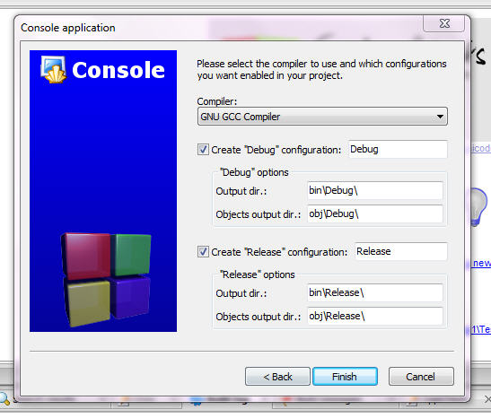
CodeBlocks: GCC Compiler

Slide 10
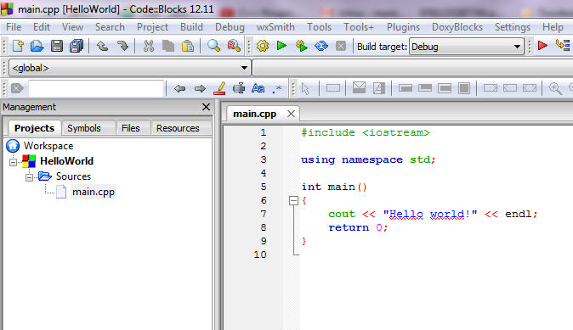
CodeBlocks: The project

Slide 11
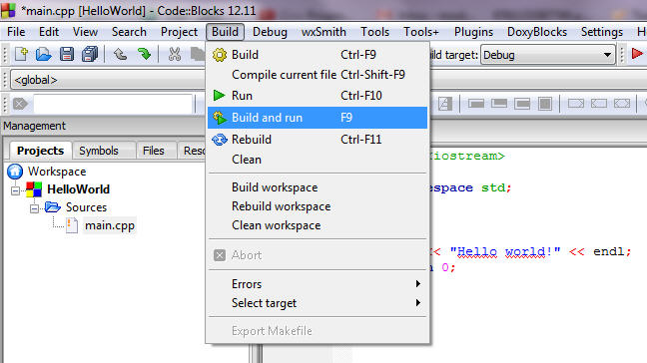
CodeBlocks: Build

Slide 12
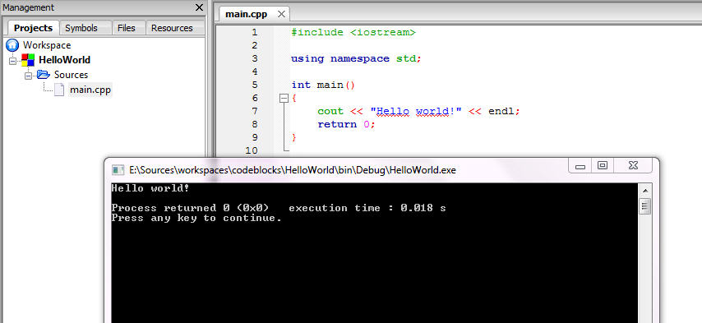
CodeBlocks: Run

Slide 13
Optional
Notes and Tricks

Slide 14
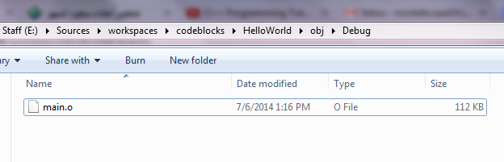
CodeBlocks: Object File
Build Command updates this file and then the exe
Compiler generates Object file, and linker use it to generate executable (exe)

Slide 15
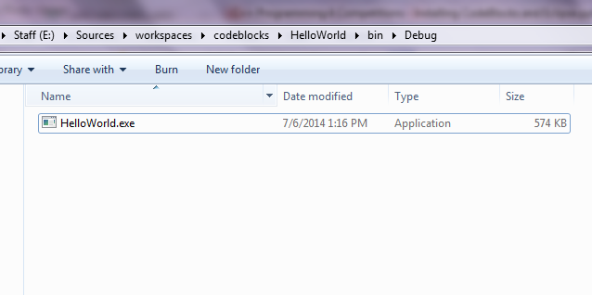
CodeBlocks: Executable
Run Command run this file
If code is updated and No Build command is issued, this file will display old program
Always Close EXE to build/run again (hence exe is replaced with new one)

Slide 16

CodeBlocks: Warning Level
When we start to code..we do mistakes
Some are acceptable => Warnings
Some are not => Errors
GCC Compiler hides many warnings => code may has problems
Let’s fix that => GCC please show more warnings
Go to: Settings => Compiler then mark 2 things:

Slide 17
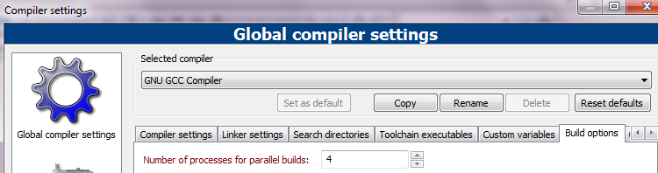
CodeBlocks: Fast CodeBlocks
If you have more than Core, let’s code blocks utilize the
Go to: Settings => Compiler => Build Options then

Slide 18
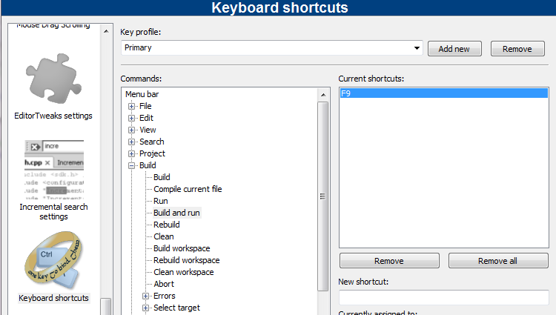
CodeBlocks: Change Shortcuts
Go to: Settings => Editor => Keyboard shortcuts

Slide 19
CodeBlocks: More Features
From time to time pick a menu and play with its content
Editor Menu has too many nice options that you may like it
Be careful to not corrupt something..if did, see if there is default settings option

